Slide 1
Project Title:
Project Team Members Name
Project Supervisor Name
Affiliation

Slide 2
Content

Slide 3
Introduction

Slide 4
Literature survey

Slide 5
Aim and Objectives

Slide 6
Methodology

Slide 7
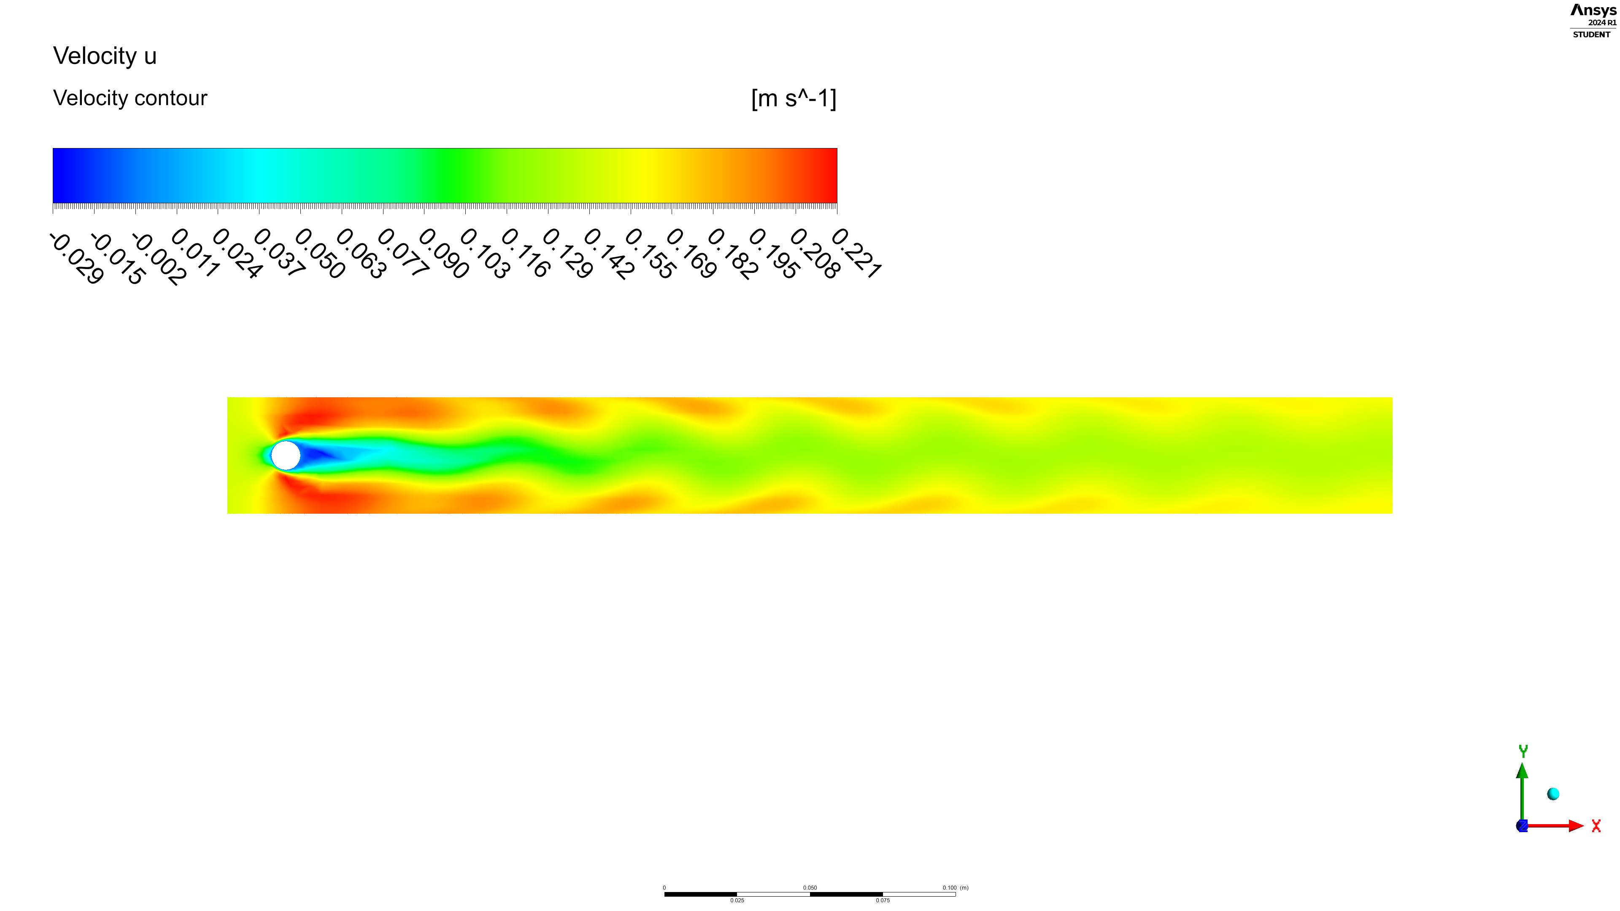
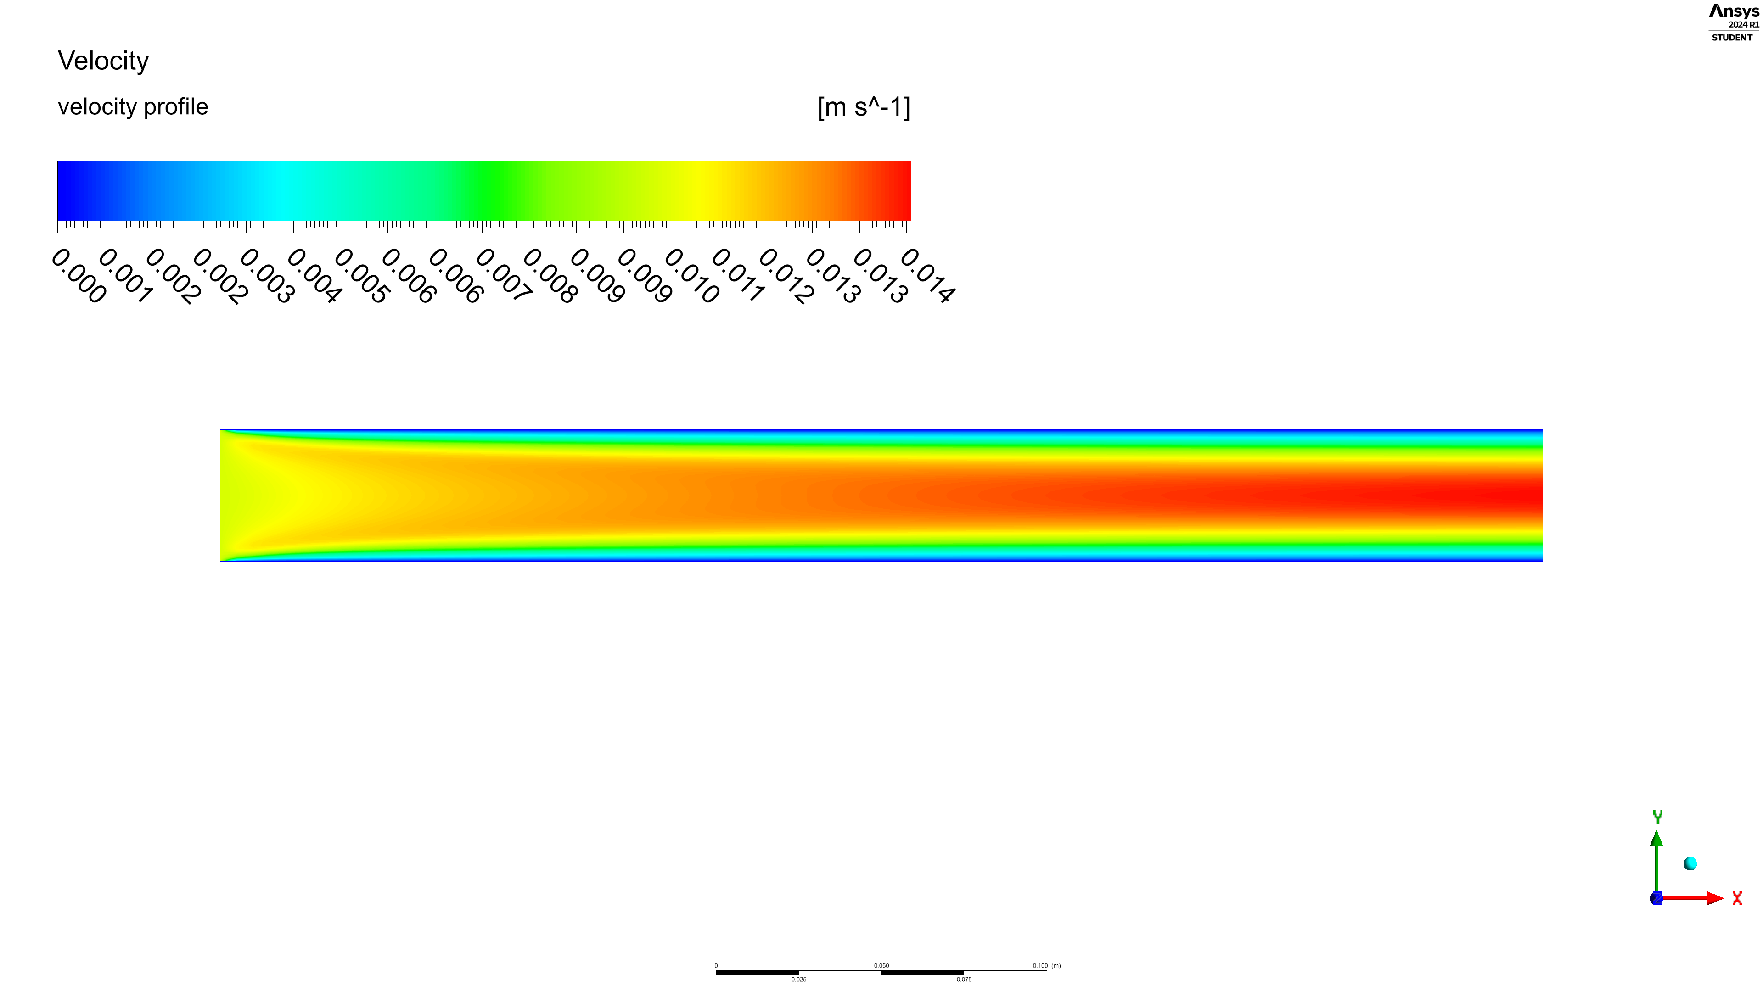
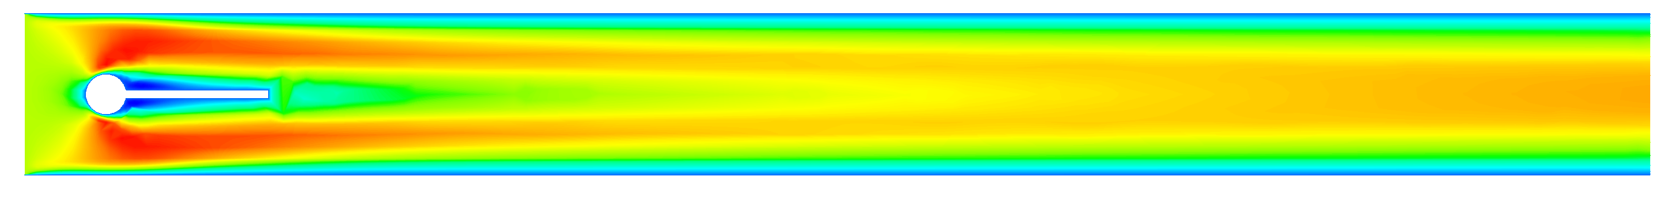
Results & Discussion

Slide 8
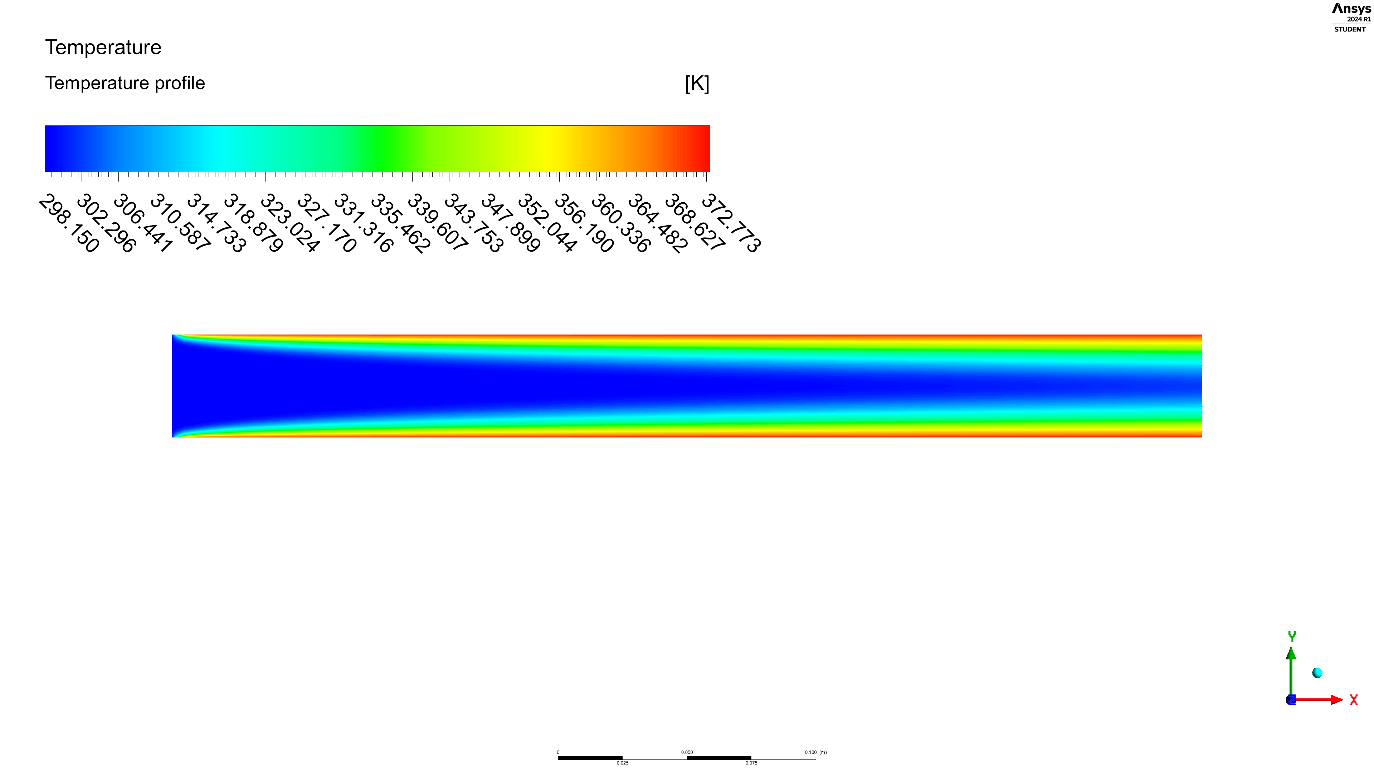
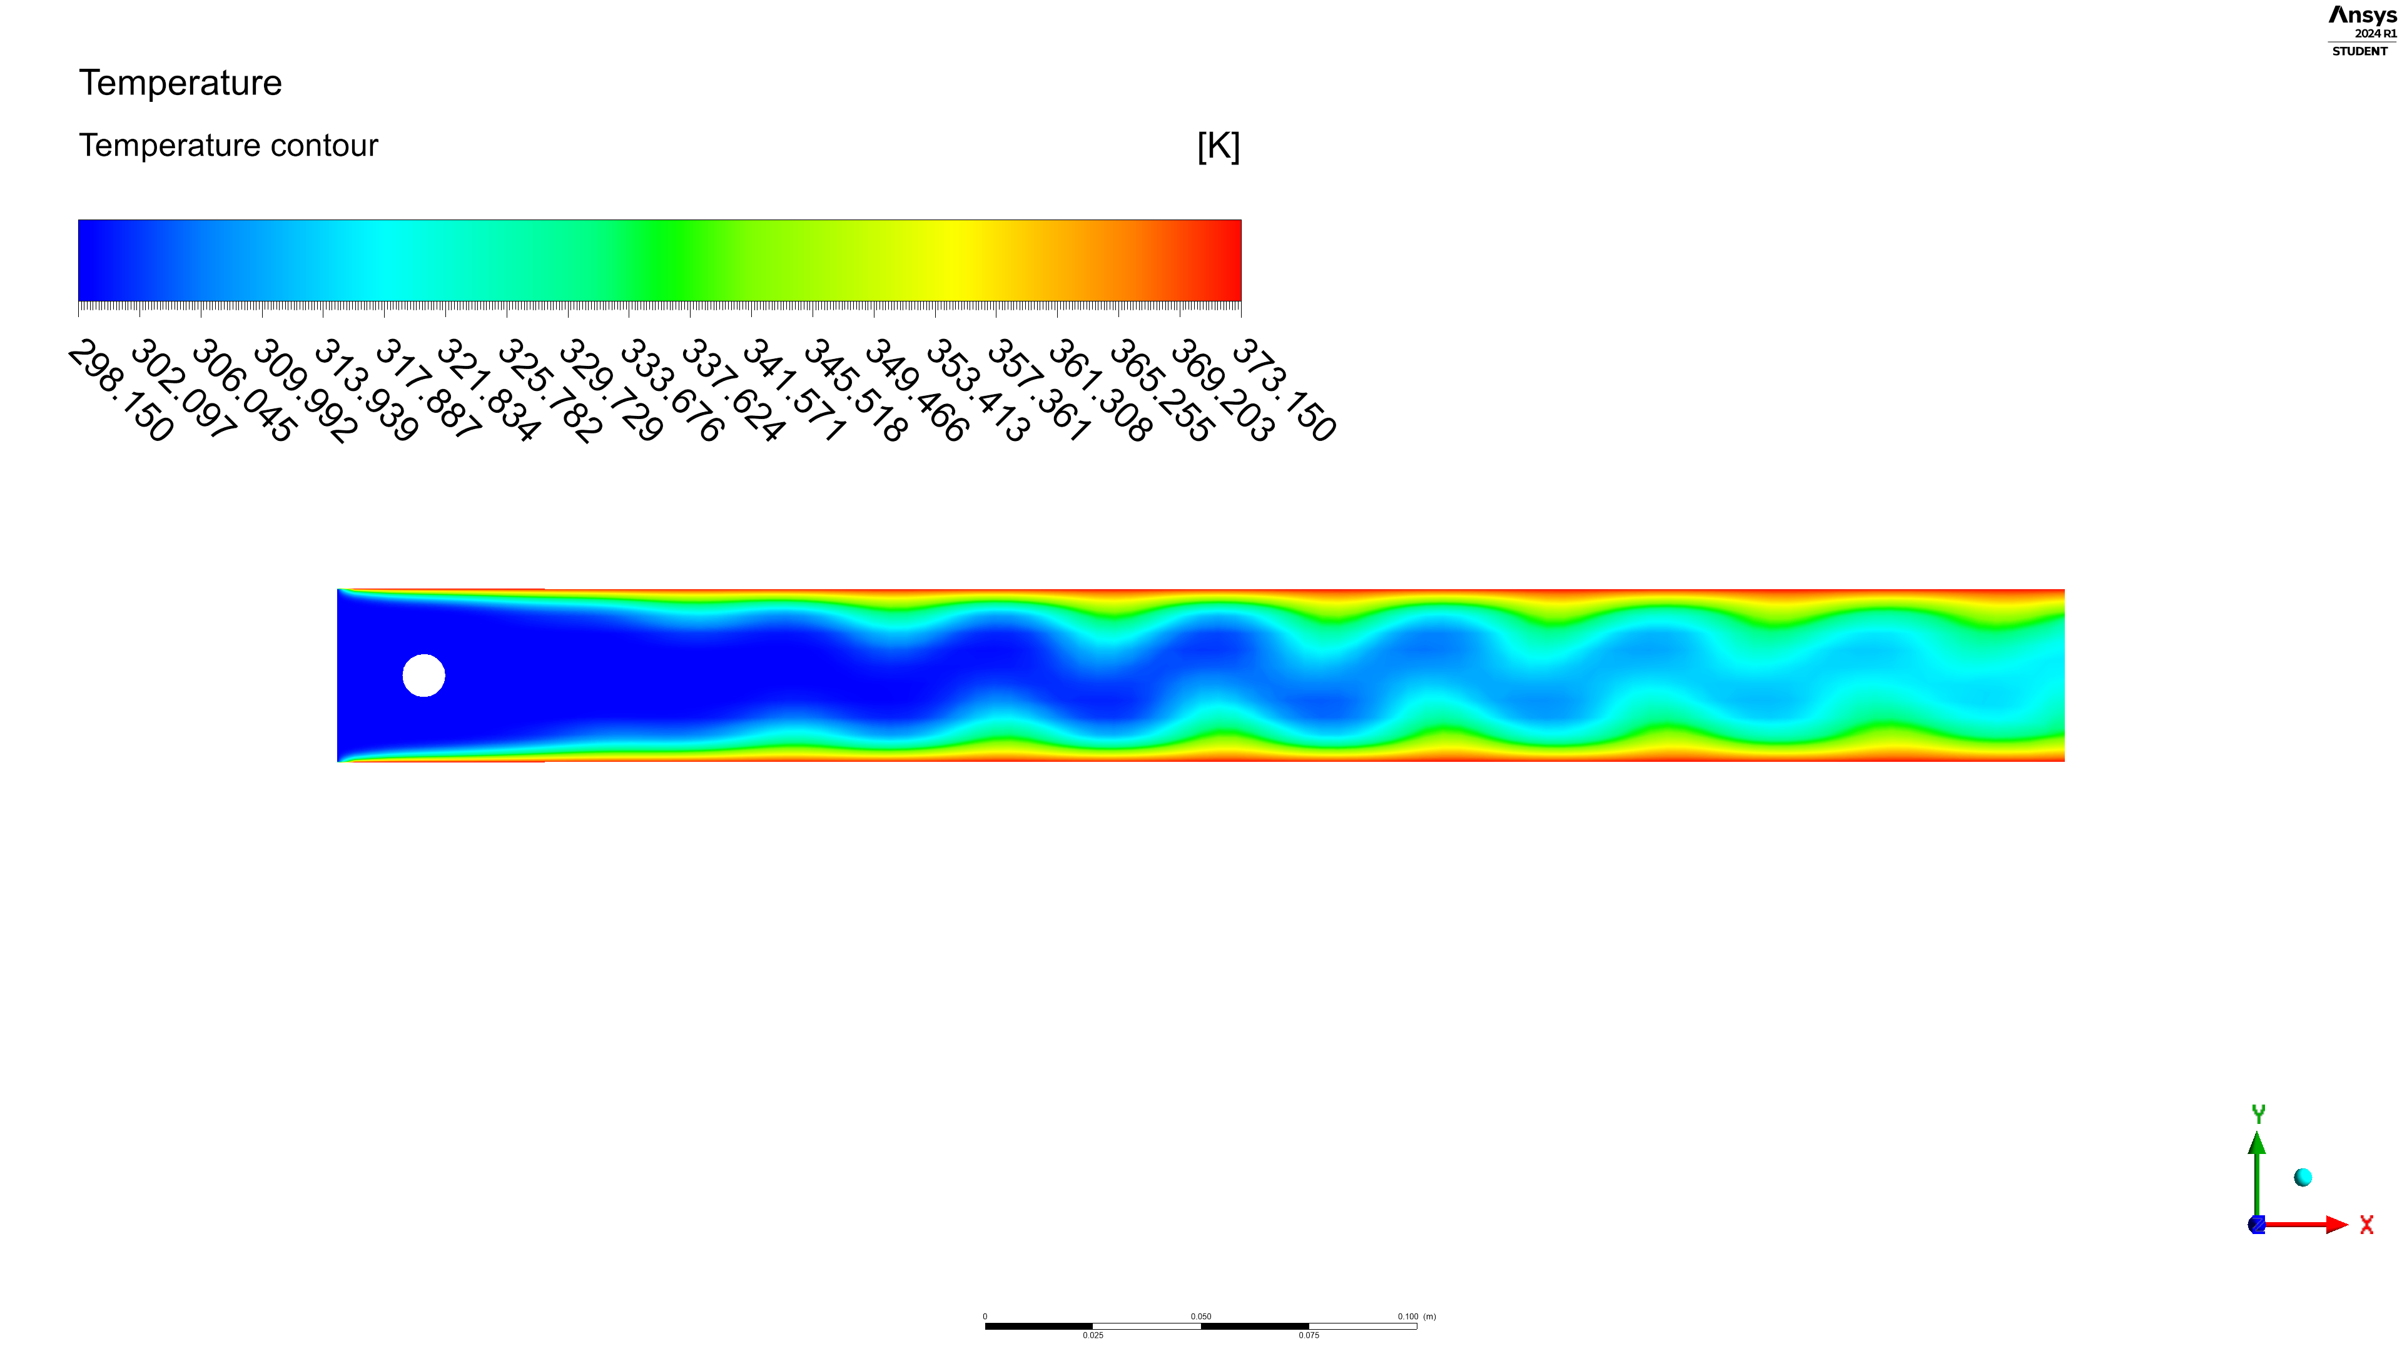
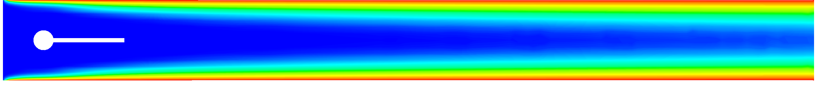
Results & Discussion

Slide 9
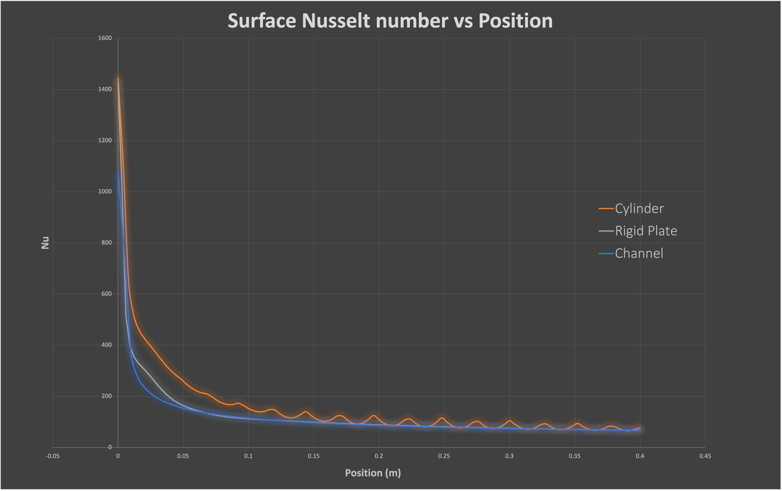
Results & Discussion

Slide 10
Design of Equipment

Slide 11
Conclusion and Future Work

Slide 12
Reference
Provide details of up to 4 most significant & recent papers

Slide 13
Outcome of This Project

Slide 14
Acknowledgement

Slide 15
Thank You

